Slide 1

Fundamentals of Artificial Intelligence
Adversarial Search
Instructor: Dr. Hatim Alsuwat
Umm Al-Qura University

Slide 2
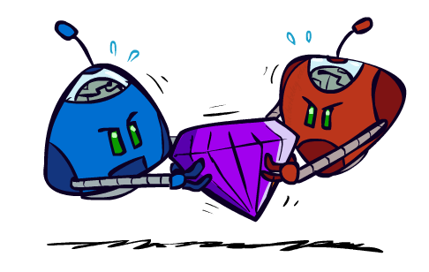
Adversarial Games

Slide 3

Types of Games
Many different kinds of games!
Axes:
Deterministic or stochastic?
One, two, or more players?
Zero sum?
Perfect information (can you see the state)?
Want algorithms for calculating a strategy (policy) which recommends a move from each state

Slide 4

Deterministic Games
Many possible formalizations, one is:
States: S (start at s₀)
Players: P={1...N} (usually take turns)
Actions: A (may depend on player / state)
Transition Function: SxA → S
Terminal Test: S → {t,f}
Terminal Utilities: SxP → R
Solution for a player is a policy: S → A

Slide 5
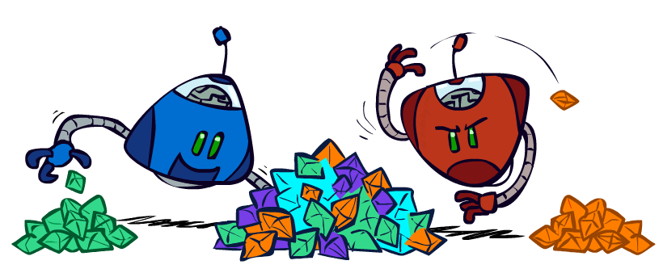
Zero-Sum Games
Zero-Sum Games
Agents have opposite utilities (values on outcomes)
Lets us think of a single value that one maximizes and the other minimizes
Adversarial, pure competition
General Games
Agents have independent utilities (values on outcomes)
Cooperation, indifference, competition, and more are all possible
More later on non-zero-sum games

Slide 6

Adversarial Search

Slide 7
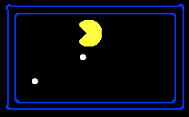
Single-Agent Trees
8
2
0
…
2
6
…
4
6

Slide 8
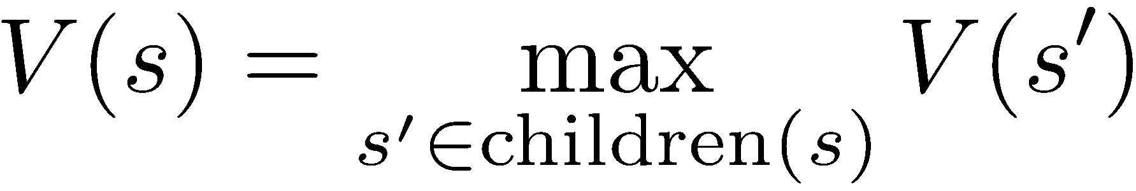
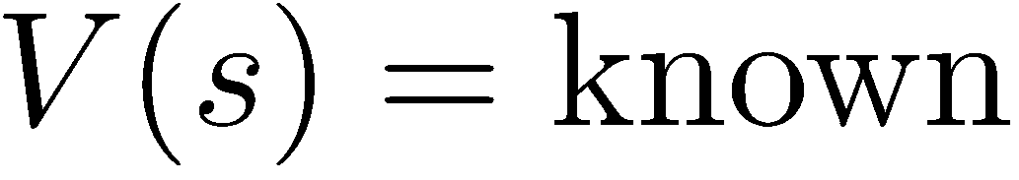
Value of a State
Value of a state: The best achievable outcome (utility) from that state
Non-Terminal States:
8
2
0
…
2
6
…
4
6
Terminal States:

Slide 9

Adversarial Game Trees
-20
-8
…
-18
-5
…
-10
+4
-20
+8

Slide 10
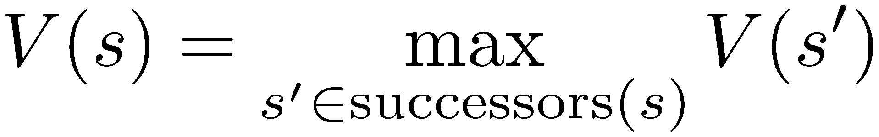
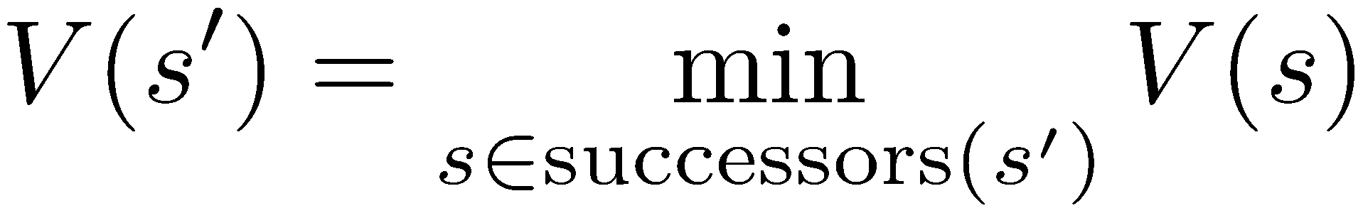
Minimax Values
States Under Agent’s Control:
States Under Opponent’s Control:
-8
-5
-10
+8
Terminal States:

Slide 11

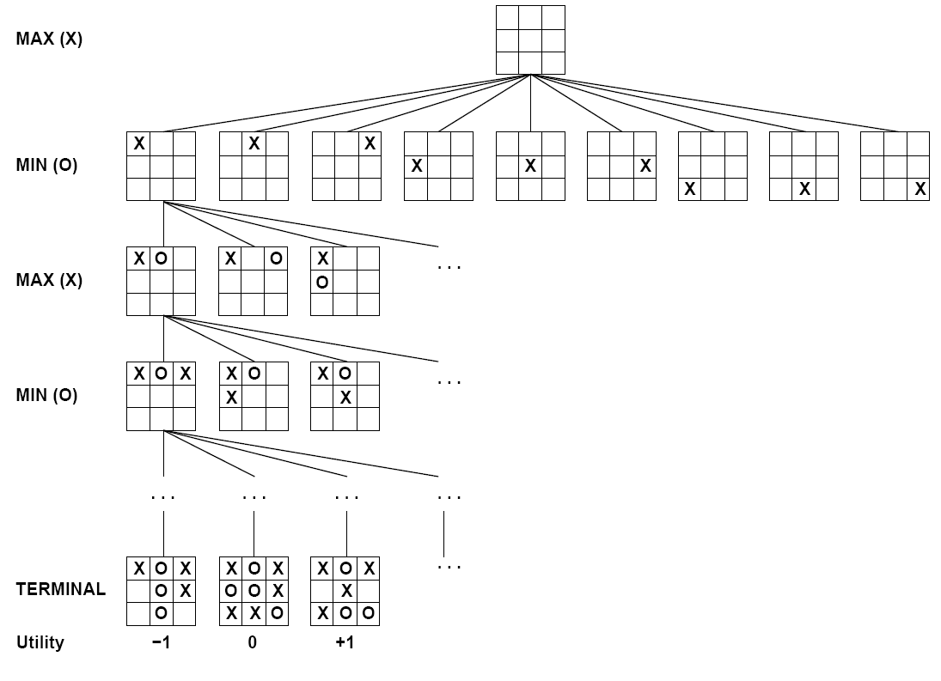

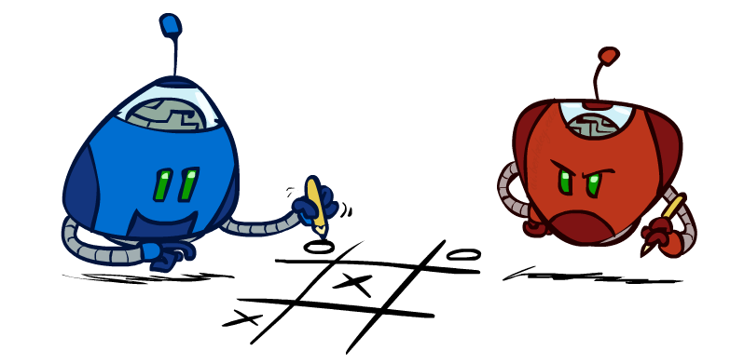
Tic-Tac-Toe Game Tree

Slide 12
Adversarial Search (Minimax)
Deterministic, zero-sum games:
Tic-tac-toe, chess, checkers
One player maximizes result
The other minimizes result
Minimax search:
A state-space search tree
Players alternate turns
Compute each node’s minimax value: the best achievable utility against a rational (optimal) adversary
Minimax values: computed recursively
5
max
2
5
min
8
2
5
6
Terminal values: part of the game

Slide 13
Minimax Implementation
def max-value(state):
initialize v = -∞
for each successor of state:
v = max(v, min-value(successor))
return v
def min-value(state):
initialize v = +∞
for each successor of state:
v = min(v, max-value(successor))
return v

Slide 14
Minimax Example
3
12
8
2
4
6
14
5
2

Slide 15
Minimax Efficiency
How efficient is minimax?
Just like (exhaustive) DFS
Time: O(b^{m})
Space: O(bm)
Example: For chess, b ≈ 35, m ≈ 100
Exact solution is completely infeasible
But, do we need to explore the whole tree?

Slide 16

Resource Limits

Slide 17
Resource Limits
Problem: In realistic games, cannot search to leaves!
Solution: Depth-limited search
Instead, search only to a limited depth in the tree
Replace terminal utilities with an evaluation function for non-terminal positions
Example:
Suppose we have 100 seconds, can explore 10K nodes / sec
So can check 1M nodes per move
α-β reaches about depth 8 – decent chess program
Guarantee of optimal play is gone
More plies makes a BIG difference
Use iterative deepening for an anytime algorithm
max
4
-2
4
min
-1
-2
4
9
?
?
?
?

Slide 18


Depth Matters
Evaluation functions are always imperfect
The deeper in the tree the evaluation function is buried, the less the quality of the evaluation function matters
An important example of the tradeoff between complexity of features and complexity of computation
[Demo: depth limited (L6D4, L6D5)]

Slide 19

Video of Demo Limited Depth (2)

Slide 20
Video of Demo Limited Depth (10)

Slide 21
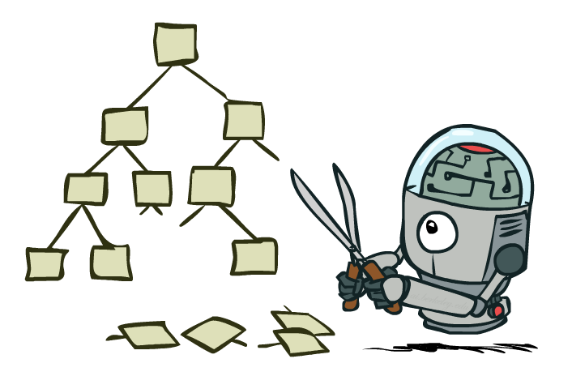
Game Tree Pruning

Slide 22
Minimax Example
3
12
8
2
4
6
14
5
2

Slide 23
Minimax Pruning
3
12
8
2
14
5
2

Slide 24
Alpha-Beta Pruning
General configuration (MIN version)
We’re computing the MIN-VALUE at some node n
We’re looping over n’s children
n’s estimate of the childrens’ min is dropping
Who cares about n’s value? MAX
Let a be the best value that MAX can get at any choice point along the current path from the root
If n becomes worse than a, MAX will avoid it, so we can stop considering n’s other children (it’s already bad enough that it won’t be played)
MAX version is symmetric
MAX
MIN
a
MAX
MIN
n

Slide 25
Alpha-Beta Implementation
α: MAX’s best option on path to root
β: MIN’s best option on path to root
def max-value(state, α, β):
initialize v = -∞
for each successor of state:
v = max(v, value(successor, α, β))
if v ≥ β return v
α = max(α, v)
return v
def min-value(state , α, β):
initialize v = +∞
for each successor of state:
v = min(v, value(successor, α, β))
if v ≤ α return v
β = min(β, v)
return v

Slide 26
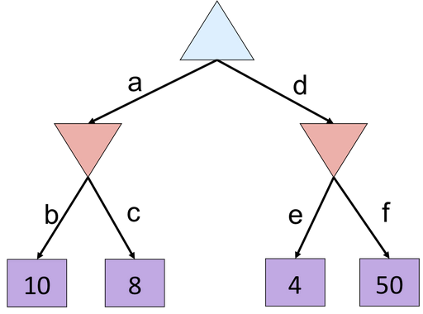
Alpha-Beta Quiz

Slide 27
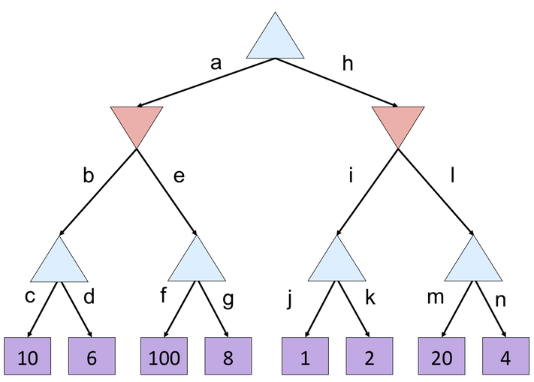
Alpha-Beta Quiz 2

Slide 28
Next Time: Uncertainty!

